Slide 1
ACTFL 2014 Spanish at a Distance: Tools, Tips and Templates for Success
Jennifer Despain
Scott Despain
NC State University
Notes:
Intro
Taught 10 years
Teaching now
Here because there’s no room in the other sections

Slide 2
History and Development of course
1998 – Scott’s face-to-face course, recorded and streamed live; 1 instructor
2004 – Jennifer’s class, recorded & edited; 2 instructors
2008 – Talking-head format; modularized and structured
2009 - Delta Testing/Proctoring, addition of TAs
2012 – Added Youtube delivery; recorded paired activities vs email
2014 - Skype introductory conference sessions – Full circle
Notes:
1998 –
2004 –
2008 – Based on Home schooling and online class that we took; encouraged a more engaged experience and emotionally invested, vs a passive learner
2009
2012`- Current generation of students was used to short snippets of entertainment, shorter attention span, problems with WMV and PC/Mac computers; enhanced class experience for the students;
2014 – Louise Dolan, individual campus session

Slide 3
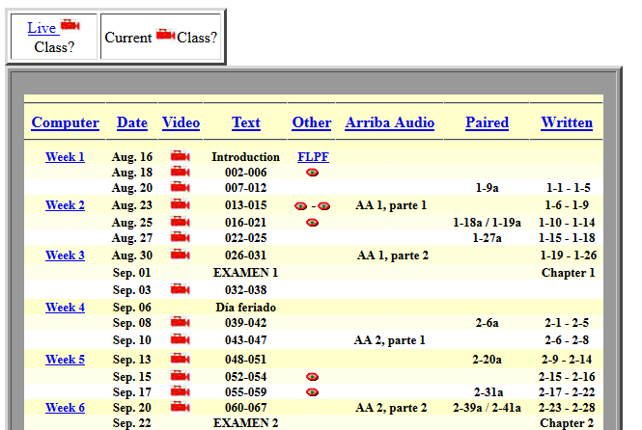
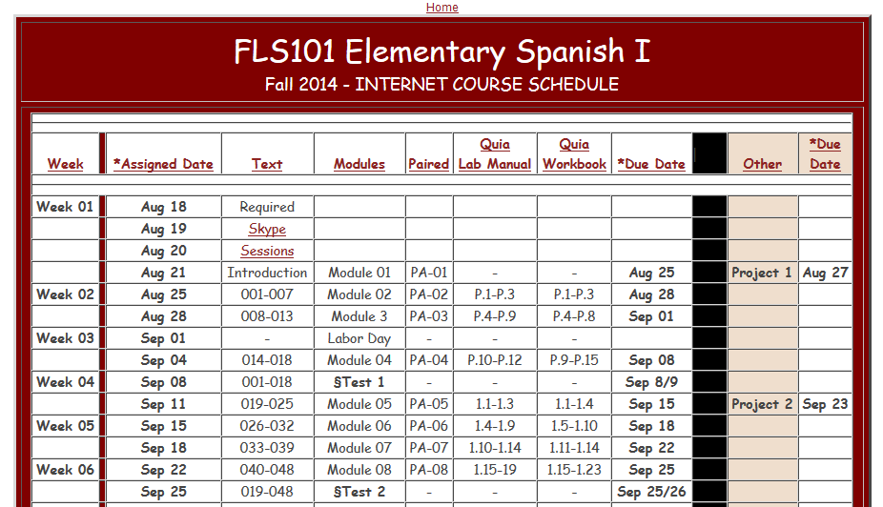
1998 vs 2014

Slide 4
Positive Teacher / Student Relationship
Pre-semester mandatory introductory Skype session (20 min)
Semester/Schedule review prior to the session
Review time commitment and time management skills
Review schedule and key deadlines
Resolve tech questions/concerns
Course mate possibilities

Slide 5
Syllabus & Dynamic Schedule
Expectations / Rules
Firm, specific and predictable
No late work accepted - BUT drop # of assignments
Full chapter posting / 72 hour window
First chapter learning curve for delivery/submission approach
Notes:
Distance Student profile – models, soldiers, brides, full-time students, internships
Expectations / Rules
Firm, specific, predictable
No late work accepted - BUT drop # of assignments
Grace Period:1 Wk / 1 Ch. learning curve of delivery/submission methods
Student View Screenshot - email, hw, mod. vid, schedule

Slide 6
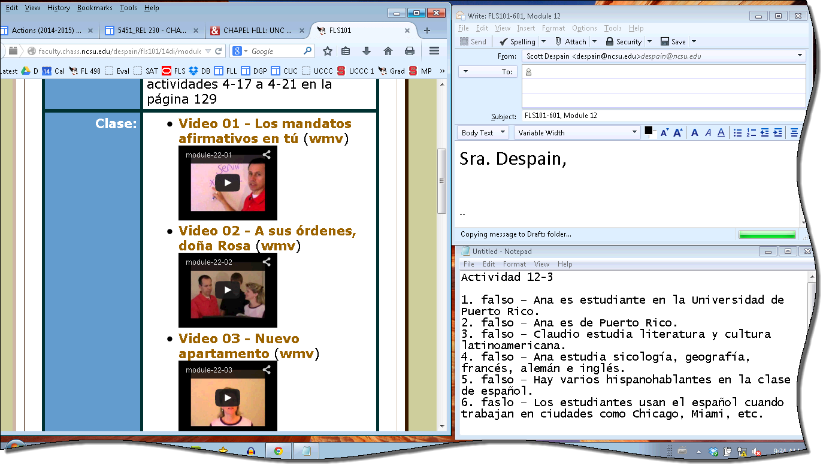
Instructional Modules
Module sample
Talking head vs. taping of class sessions
WMV and YouTube video for ease of access
Update material with each new textbook edition
Smaller segments of instruction
Student’s view …
Humor – Student motivation, interest and engagement
Notes:
-Video delivery via Youtube for easy access
Talking head vs. taping of class - increases FEEL of 100% attention
Update material as new editions are adopted - no 2nd class citizens
Small bites - drink through straw not fire hose
(Video 1 Kids /Video 2 DIrect Instruction / Video 3 Modeling)
Humor - it’s critical to motivate students to want to continue

Slide 7
Video Samples
Notes:
-Video delivery via Youtube for easy access
Talking head vs. taping of class - increases FEEL of 100% attention
Update material as new editions are adopted - no 2nd class citizens
Small bites - drink through straw not fire hose
(Video 1 Kids /Video 2 DIrect Instruction / Video 3 Modeling)
Humor - it’s critical to motivate students to want to continue

Slide 8
Language Production and Evaluation
Interactive module videos
Course mates - Fellow student, spouse, friend, co-worker
Audacity recordings of paired activities / Dropbox
Quia listening comprehension exercises
Projects – One-on-one communication with instructor
Notes:
Coursemates (within course or family, friend, co-worker)
Listening Comprehension Exercises (modeled behavior of best practice)
Audacity & Dropbox
Projects - one-on-one communication with instructor (TA) 3 x’s during semester

Slide 9
Our Tools
Audacity – Open Source Audio Editor
Windows Movie Maker – Video Editing Software
Skype – Internet-based communications
$ Dreamweaver – Web space editor
Google Docs – Collaborative web-based office suite
Dropbox – Collaborative on-line storage
Notes:
Audacity – Students use to do some recording for projects
Windows Movie Maker – Used to create the talking-head videos for the modules
Skype – Used for pre-course conference calls with students and for TA/student interaction
Dreamweaver – Used to maintain the web space – although other products could be used
Google Docs – used for the projeocts to set up call in times, used to track scores for the instructors

Slide 10
Instructors’ Roles
Instructor 1: Regular email updates or common concerns, progress reports, Updates grades
Instructor 2: Technical Assistance; maintain course
TA: Interactive Projects (phone, Skype), Tutoring sessions, Grading
Feedback on assignments within a reasonable time frame - 24 hrs

Slide 11
Delivery: To Moodle or not to Moodle
Some students/instructors prefer an LMS
Control of delivery and availability
Organization of material and prompts
Keeping material open and accessible

Slide 12
Completion Rates

Slide 13
Achievement Results

Slide 14
Other questions or Comments?

Slide 15
Contact Information
Scott Despain, PhD NC State University Campus Box 8106 Raleigh, NC 27695-8106 Phone: (919) 513-1482 E-mail: despain@ncsu.edu http://faculty.chass.ncsu.edu/despain/ | Jennifer Despain NC State University Campus Box 8106 Raleigh, NC 27695-8106 Phone: (919) 513-1482 E-mail: jhdespai@ncsu.edu http://www4.ncsu.edu/~jhdespai/

